Slide 1
Ryan White Planning Council
Aged Needs Assessment
2019

Slide 2
HIV & AGING
Currently in the United States, over half of people living with HIV are 50 or over. These individuals are coping with 2 challenges, the stresses of growing older along with the challenges of living with HIV.
The purpose of this needs assessment is to address any unique needs or challenges that our clients may be facing as someone who is 50 or older living with HIV.

Slide 3
REQUIREMENTS
Being 50 years of age or older
Being HIV positive
Living in New Haven or Fairfield Counties

Slide 4
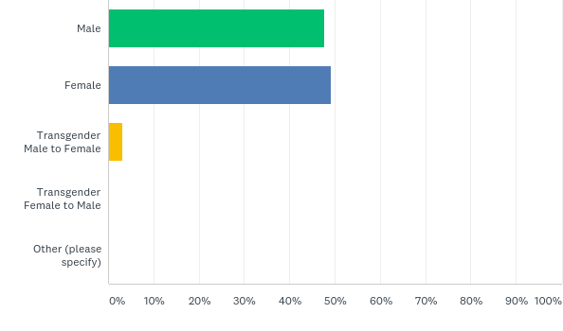
GENDER IDENTITY
48%
49%
3%

Slide 5
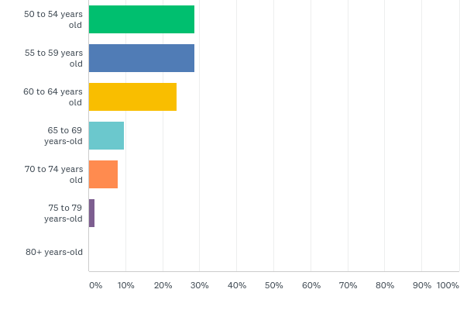
AGE RANGES
28%
28%
24%
10%
8%
2%

Slide 6
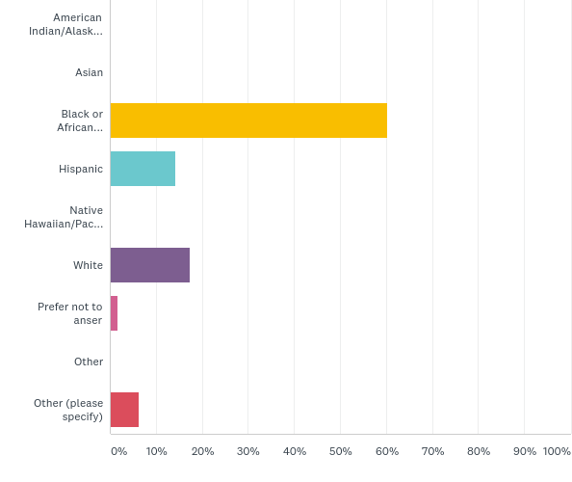
RACE/ETHNICITY
28%
60%
28%
14%
24%
10%
17%
8%
2%
2%
6%
3: Puerto Rican, 1: Black & Native American Indian

Slide 7
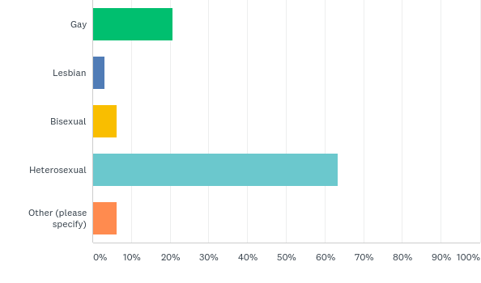
SEXUAL ORIENTATION
21%
3%
6%
63%
6%
2 transsexual, 1 none

Slide 8
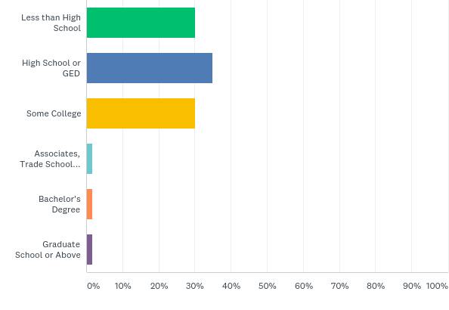
30%
LEVEL OF EDUCATION
40%
30%
2%
2%
2%

Slide 9
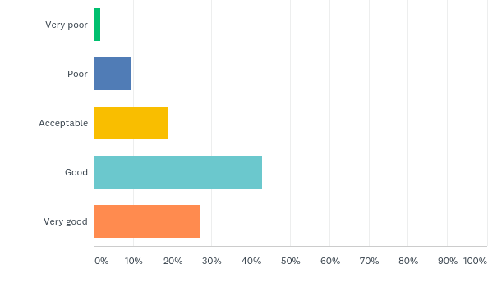
OVERALL HEALTH
2%
10%
19%
43%
27%

Slide 10
MOST COMMON CONDITIONS
Asthma 32%
Arthritis 56%
Behavioral Mental Health Diagnosis 46%
Bronchitis 25%
Diabetes 22%
Headaches/Migraines 30%
Hepatitis (A,B,C) 41%
High Cholesterol 29%
Hypertension 49%
Sleep Disorder 30%
Substance Use 29%

Slide 11
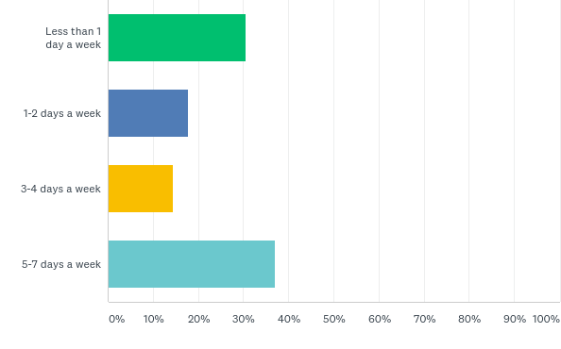
HOW OFTEN DO YOU PARTICIPATE
IN PHYSICAL ACTIVITIES
31%
18%
15%
37%

Slide 12
SUMMARY OF INFORMATION
What are your overall eating habits? 78% of people who answered this feel that they eat between somewhat healthy and very healthy
Have you ever received Ryan White Services? 27% people who answered this feel said that they have never received services from Ryan White.
What is your work status? 51% of people who answered this are unable to work due to having a disability
What is your housing situation? 70% people who answered this rent an apartment or a home
Types of problems you have? The most common problems we heard about were struggling financially, feeling bored and difficulty getting clothing and personal care supplies

Slide 13
Quality of Life
87% of people who answered this feel their quality of life is between acceptable and very good
Over 30% of people felt Depression, isolation, survivors' guilt, cognitive impairment, poor concentration and loss of memory
Between 61%-79% of people feel connected to their neighbors, safe in their home, have someone to call if they need help and have people they can count on
Over 60% of people felt they need emotional support sometimes and 56% of them go to support groups and they all find them helpful.
Most Pressing Issues in your Community: Alcohol and drug abuse, housing affordability, homelessness, access to healthy food, lack of transportation and mental health issues
Most Needed Services for the Aging HIV Community: Affordable housing, health and wellness programs, access to healthy food, nutrition and transportation.

Slide 14
Questions and Discussion

