Slide 1

2018 New Haven / Fairfield Counties Non-Virally Suppressed Targeted Needs Assessment
Thursday, May 3, 2018

Slide 2
Number of surveys completed by Region
 | Region 1 New Haven | Region 2 Waterbury | Region 3 Bridgeport | Region 4 Stamford/Norwalk | Region 5 Danbury | TOTAL
Total Number of Clients Identified | 77 | 37 | 51 | 57 | 10 | 232
Number of Surveys Completed | 43 | 11 | 27 | 42 | 9 | 132
If unable to contact client, please enter the total number of clients below with the related reason:
Lost to Follow Up | 34 | 20 | 22 | 14 | 1 | 91
Incarcerated | 0 | 3 | 0 | 0 | 0 | 3
Inpatient | 0 | 0 | 1 | 0 | 0 | 1
Deceased | 0 | 0 | 0 | 1 | 0 | 1
Recently Reach Viral Suppression | 0 | 3 | 1 | 19 | 0 | 23

Slide 3
How would you describe your race and ethnicity?
RACE
WHITE | BLACK/AFRICAN AMERICAN | MORE THAN ONE RACE
42 | 84 | 8
WHITE | BLACK/AFRICAN AMERICAN | MORE THAN ONE RACE
42 | 84 | 8
ETHNICITY
WHITE (NON HISPANIC) | HISPANIC | BLACK OR AFRICAN AMERICAN | AMERICAN INDIAN/ ALASKA NATIVE | MORE THAN ONE ETHNICITY
18 | 36 | 79 | 0 | 2

Slide 5
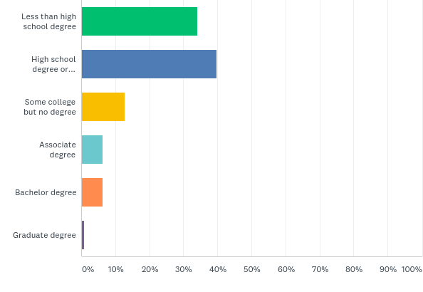
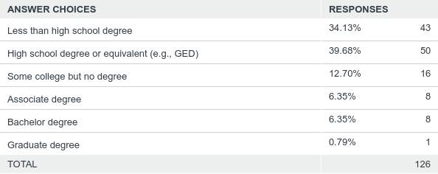
What is the highest level of school you have completed or the highest degree you have received?

Slide 6
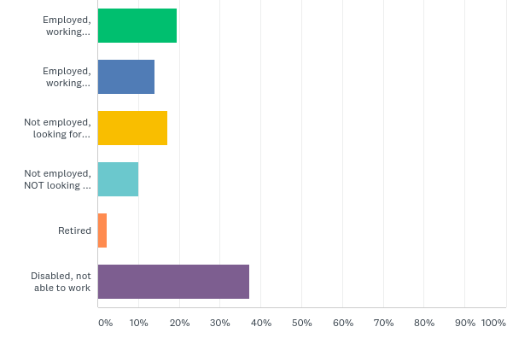
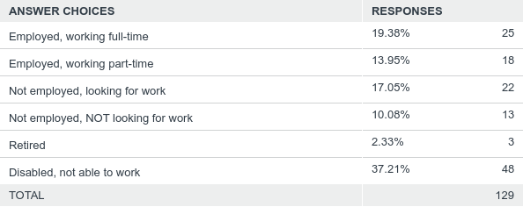
Which of the following categories best describes your employment status?

Slide 7
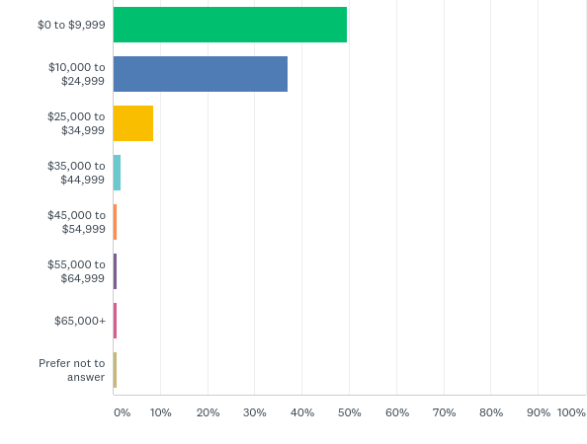
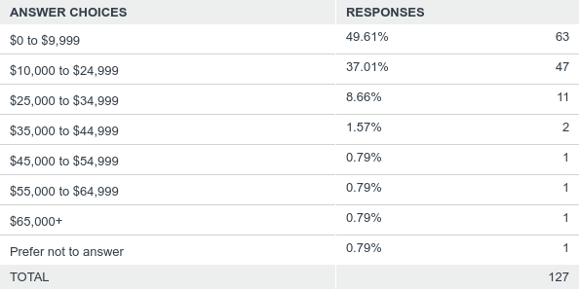
What is your total estimated income for this year?

Slide 8
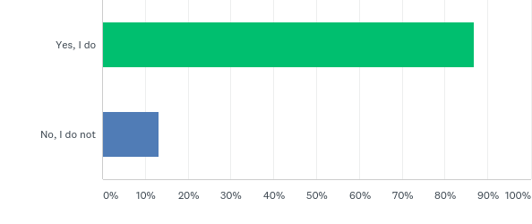
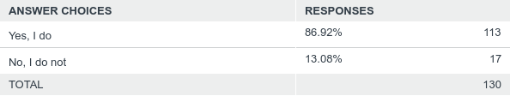
Do you currently have medical insurance?

Slide 9
What year were you first diagnosed?
YEAR | TOTAL
1980 – 1990 | 24
1991 – 2000 | 45
2001 - 2010 | 35
2011 - Current | 29

Slide 10
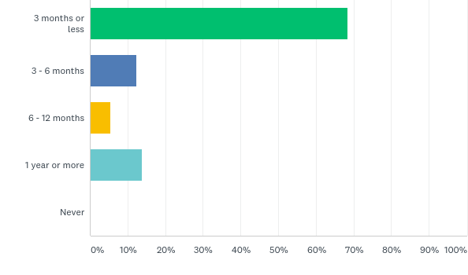
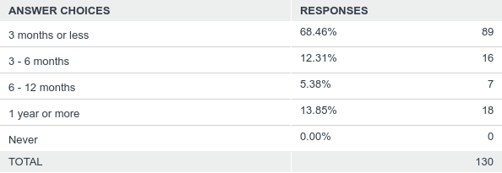
When you were first diagnosed with HIV, how long before you received medical care?

Slide 11
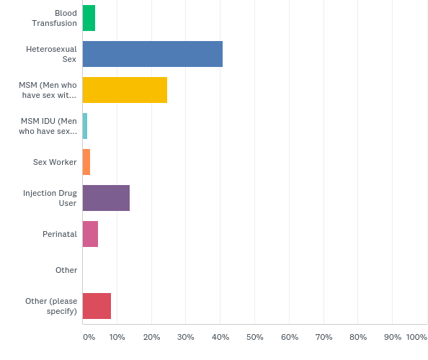
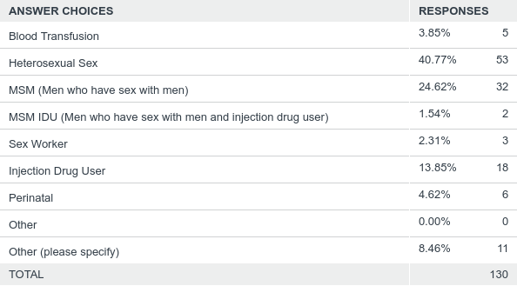
How did you contract hiv?
OTHER:
Raped in jail, injected with something and I don’t know

Slide 12
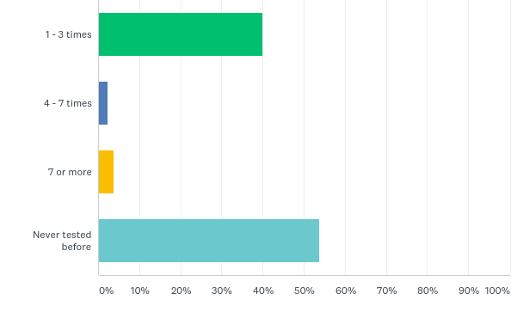
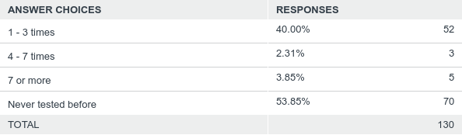
How many times before your positive diagnosis were you tested for HIV?

Slide 13
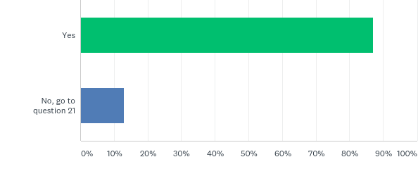
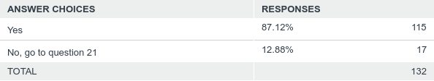
Are you currently taking HIV medications?

Slide 14
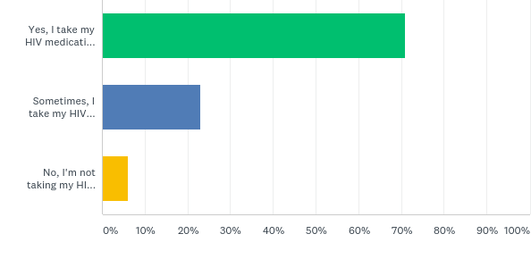
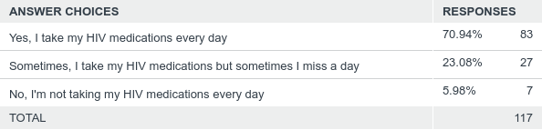
do you take your HIV medication every day as prescribed by your doctor?

Slide 15
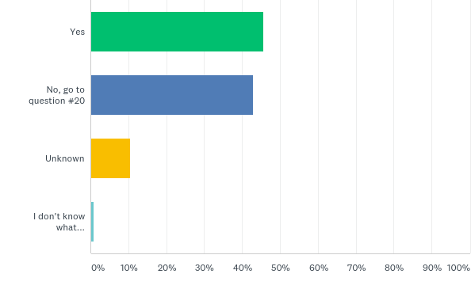
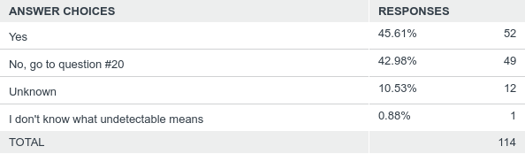
Since you are taking HIV medications, is your viral load undetectable?

Slide 16
Please tell us the reasons why you think you have an undetectable viral load
REASON | #
Take medication everyday | 46
Taking care of myself | 4
Follow up with appointments | 8
Medical care adherence | 5
Being responsible | 3
Nurse adherence | 1

Slide 17
If you're struggling with medication adherence please list three reasons why
REASON | #
I forget to take my meds | 32
Side effects of medication | 8
Depression | 8
Lack of education | 6
Addition | 4
Newly diagnosed | 3

Slide 18
Please tell us the reasons why you think you DO NOT have an undetectable viral load
REASON | #
I forget | 23
Side effects | 7
Depression | 7
Addiction | 6
Tired of taking medication | 4
No insurance | 3
Feeling OK | 2
Lack of education | 2
Embarrassing | 2
No prescription | 2

Slide 19


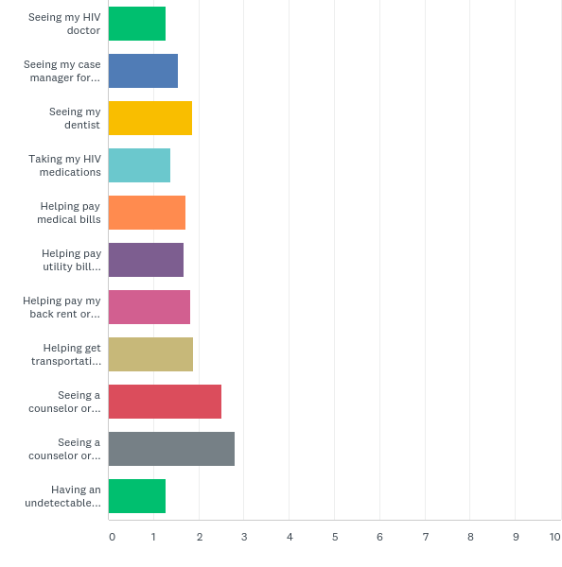
How important are the following HIV services to you?

Slide 20
DATA TRENDS FROM SURVEY RESULTS
Gender | How would you describe your race? | How would you describe your ethnicity? | How did you contract HIV? | #
Female | Black or African-American | Black or African American | Heterosexual Sex | 22
Male | Black or African-American | Black or African American | MSM (Men who have sex with men) | 14
Male | Black or African-American | Black or African American | Heterosexual Sex | 13
Male | Black or African-American | Hispanic | MSM (Men who have sex with men) | 11
Female | Black or African-American | Hispanic | Heterosexual Sex | 7
Male | Black or African-American | Hispanic | Heterosexual Sex | 6
Male | White | White (Non-Hispanic) | MSM (Men who have sex with men) | 6
Male | Black or African-American | Black or African American | Injection Drug User | 5
Female | Black or African-American | Black or African American | Blood Transfusion | 3
Female | Black or African-American | Black or African American | Injection Drug User | 3
Female | Black or African-American | Hispanic | Injection Drug User | 3

Slide 21
DATA TRENDS FROM DATA REQUEST
Gender | How would you describe your race? | How would you describe your ethnicity? | How did you contract HIV? | #
Female | Black or African-American | Black or African-American | Heterosexual | 39
Male | Black or African-American | Black or African-American | MSM | 21
Female | White | Hispanic | Heterosexual | 20
Male | Black or African-American | Black or African-American | Heterosexual | 19
Male | White | Hispanic | Heterosexual | 17
Male | Black or African-American | Black or African-American | IDU | 15
Male | Black or African-American | Hispanic | MSM | 13
Male | White | Hispanic | IDU | 12
Male | White | White (non-Hispanic) | MSM | 10
Female | White | White (non-Hispanic) | IDU | 8
Female | White | Hispanic | IDU | 6

Slide 22
DISCUSSION OR QUESTIONS?

